Slide 1


Crossover
Trading
Estimating Investments using Machine Learning
Aakanksha Satish Bagal
20BIT0190
Capstone Project - ITE1904

Slide 2


Abstract
This project investigates the efficacy of Long Short-Term Memory (LSTM) and Autoregressive Integrated Moving Average (ARIMA) models in predicting stock market trends and facilitating timely investment decisions. Leveraging data sourced from the yfinance API, we employ LSTM to forecast future stock prices, subsequently applying ARIMA to derive precise buy and sell points. Central to our approach is the incorporation of crossover analysis, wherein we utilize monthly and yearly moving averages to identify key market shifts. implementing the principles of crossover trading we identify the buy and sell points. Through rigorous experimentation and comparative analysis, we evaluate the performance of LSTM and ARIMA models in generating accurate predictions and actionable insights. Our findings contribute to the advancement of predictive analytics in financial markets, empowering investors with enhanced tools for navigating dynamic market conditions and optimizing investment strategies.

Slide 3




What is Crossover Trading?
The crossover is a point on the trading chart in which a security's price and a technical indicator line intersect, or when two indicators themselves cross. Crossovers are used to estimate the performance of a financial instrument and to predict coming changes in trend, such as reversals or breakouts.

Slide 4
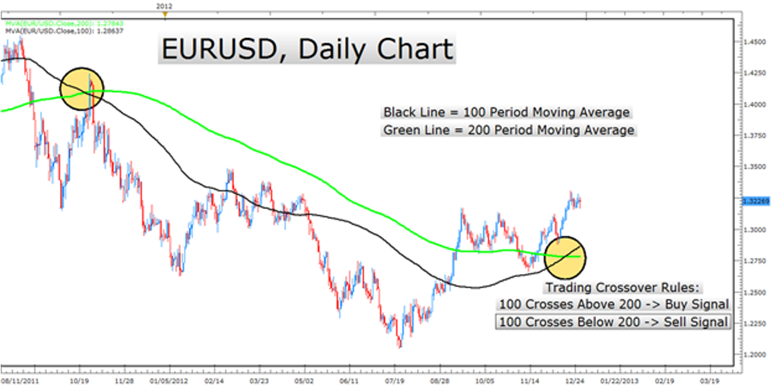

Slide 5




Objective
The objective of this project is to predict stock market prices using a Long Short-Term Memory (LSTM) algorithm and enhance trading strategies through the identification of buy and sell points with an ARIMA model-based crossover trading strategy.
– LSTM for Price Prediction: Utilize LSTM to forecast stock prices by analyzing historical data, capitalizing on its ability to remember long-term dependencies.
– ARIMA for Trading Signals: Implement ARIMA to generate crossover trading signals, identifying optimal moments to buy or sell based on predicted prices.
– Combine LSTM and ARIMA: Integrate LSTM predictions with ARIMA signals to refine trading strategies, aiming for higher accuracy in market entry and exit points.
– Optimize and Evaluate: Continuously optimize and evaluate the models to ensure their effectiveness and adaptability to market changes.
– Provide actionable insights for traders, aiming to enhance decision-making and potential profitability in the stock market through advanced predictive analytics.

Slide 6
The Moving Average Crossover strategy: Does it work for the S&P500 Market Index? (2018)
By Ikhlaas Gurrib
This study aims to answer whether an optimized moving average crossover strategy based on daily data outperforms a buy and hold strategy. The research investigates the use of an optimized moving average crossover strategy for the S&P500, by using the SPDR S&P500 Exchange Traded Fund as a proxy for the US market index.
The optimized strategy is evaluated against a buy and hold strategy over the five distinct waves which were witnessed during the 1993- 2014 period. The annualized returns, annualized risk and the Sharpe performance measure are used as indicators to compare between the two strategies.
Findings tend to support higher absolute returns and risk for the buy-and-hold strategy, particularly during correction waves. When compared to the buy-and-hold strategy over the post financial crisis period, the optimized double cross over strategy resulted in a relatively lower risk and returns. The market timing strategy still outperformed the naïve buy- and-hold strategy, with a relatively higher Sharpe performance measure.
Literature
Review

Slide 7
Trading Performance Analysis: A Comparisons Between the Original MA Crossover and Modified MA Crossover Strategy (2019)
By Afiruddin Tapa, Mohd Hasimi Yaacob, Ahmad Husni Hamzah, Yean Soh Chuen
The original moving average (MA) crossover strategy is compared with the modified moving-average crossover strategy. The modified trading rules are the rules that been established to trading rules such as entry rule, exit rule, holding rule, and stoploss rule.
The results show The MA short of 10-period for modified strategy underperform the original strategy, except for MA (10,100). The modified MA (20,200), (50,100), (50,200), and (100,200) underperform the original strategy.
Only modified MA (20,50) and (20,100) outperform the original strategy. The outperformance and underperformance due to the stricter additional trading rule that reduces trading signals, and thus lower number of trades.

Slide 8
A Decision Support System for Technical Analysis of Financial Markets Based on the Moving Average Crossover(2019)
By Ihab A. El-Khodary
A decision support system was developed based on the MA crossover technique, offering descriptive statistics for time series data of market indices and securities, assessing the statistical significance of returns generated by any MA rule, and identifying the optimal MA rule producing the highest significant returns.
It also scans a group of securities for the latest signals and highest returns, with the added advantage of searching for the optimal MA rule among a large universe of MA rules. This system was utilized to investigate the predictive capabilities of the MA crossover concerning the Egyptian Exchange Stock market.
The analysis revealed that MA lengths of 1-20, 1-25, and 1-30, along with the closing price, were most profitable for the rules. The exponential MA model proved most profitable for many securities, while the simple MA model was effective for a few securities.
The findings strongly suggest that the MA crossover technique can predict the Egyptian stock market index and its securities, rejecting the null hypothesis that returns earned by the technique are equal to the unconditional buy-and-hold strategy.

Slide 9
A novel stock trading utilizing long short term memory prediction and evolutionary operating-weights strategy
By Xiaoman Huang, Chang Wu, Xiaoqi Du, Hong Wang, Ming Ye
This paper proposes a novel approach to enhance investment returns by integrating Long Short Term Memory (LSTM) predictions with the Evolutionary Operating-weights (EOW) algorithmic strategy.
The proposed method employs a multi-layer LSTM to forecast future stock prices, incorporating the predictions with real market data, subsequently deriving an operational strategy using the EOW algorithm.
The results of this research indicate that this proposed methodology outperforms existing approaches.

Slide 10

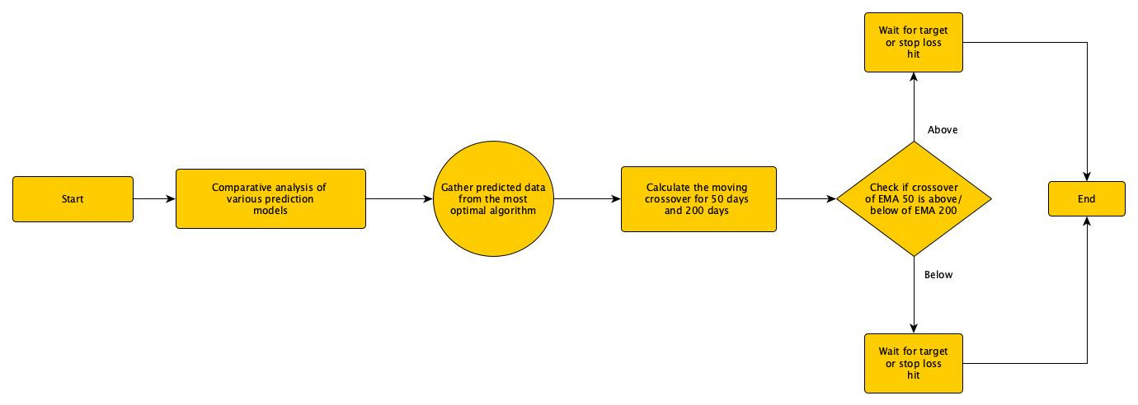

Architecture

Slide 11
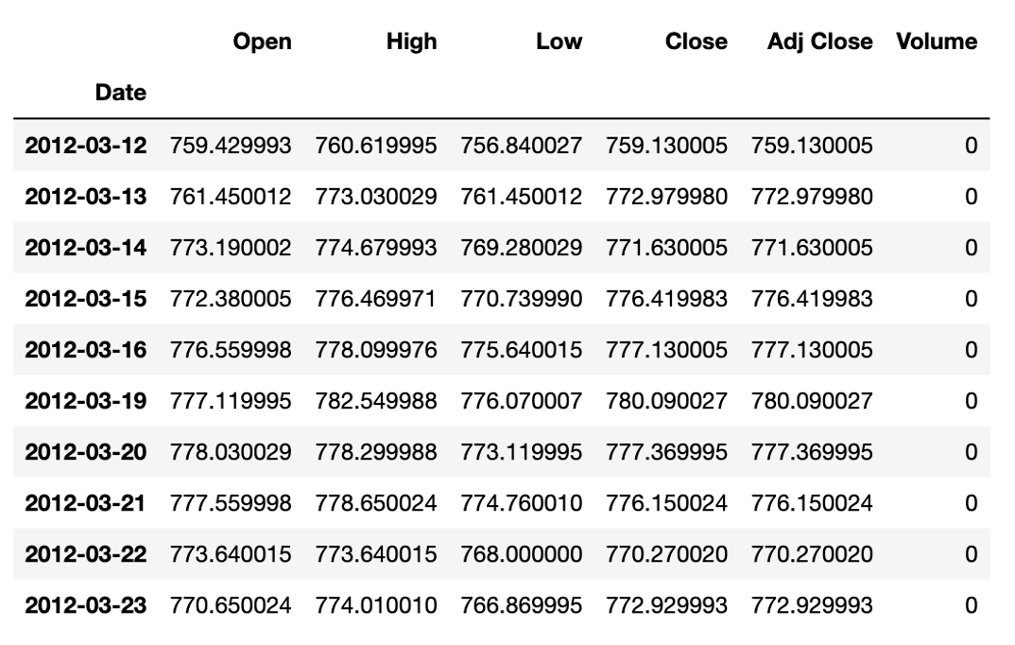

Dataset
Description
Data was fetched from yfinance (Yahoo finance) using python API keys

Slide 12

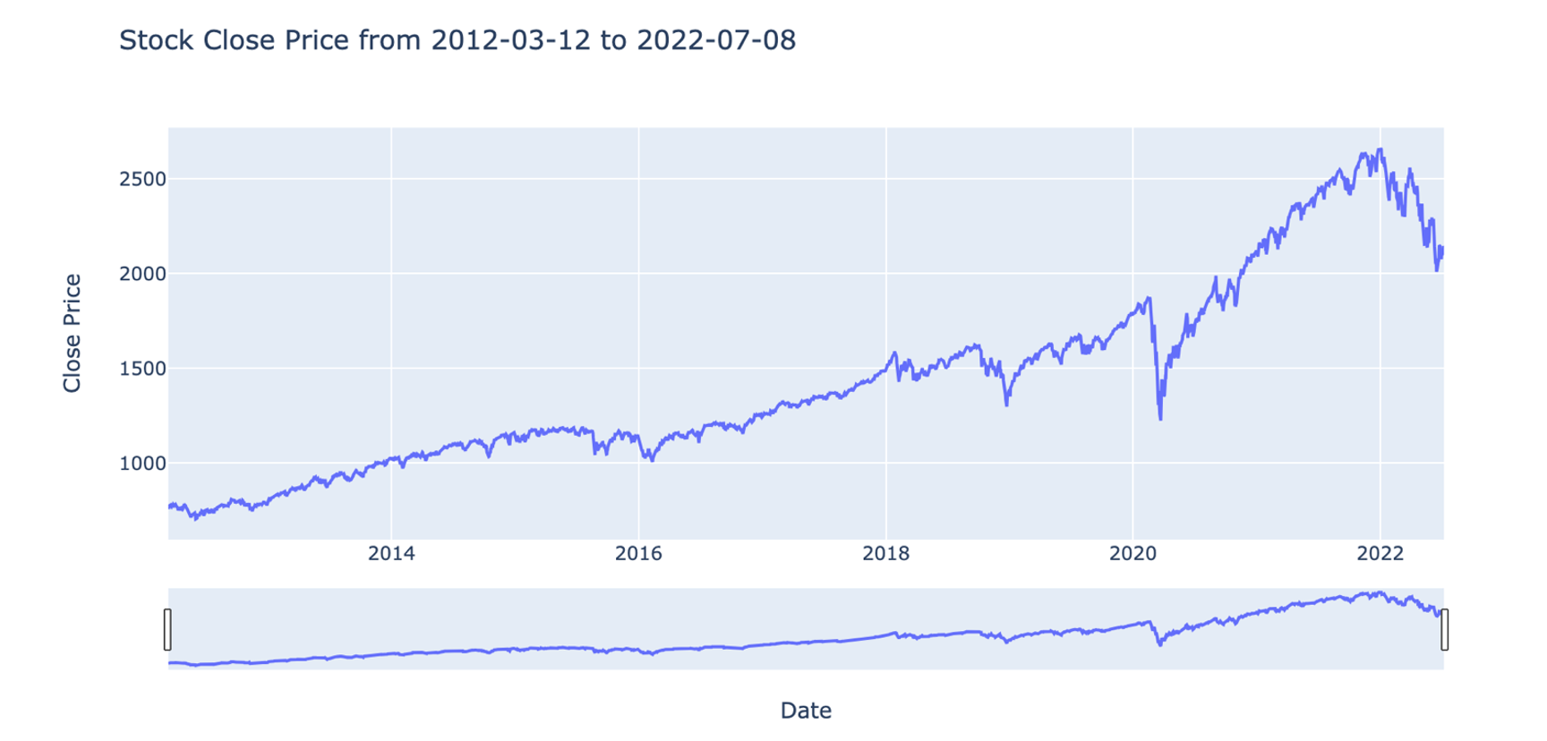


Slide 13
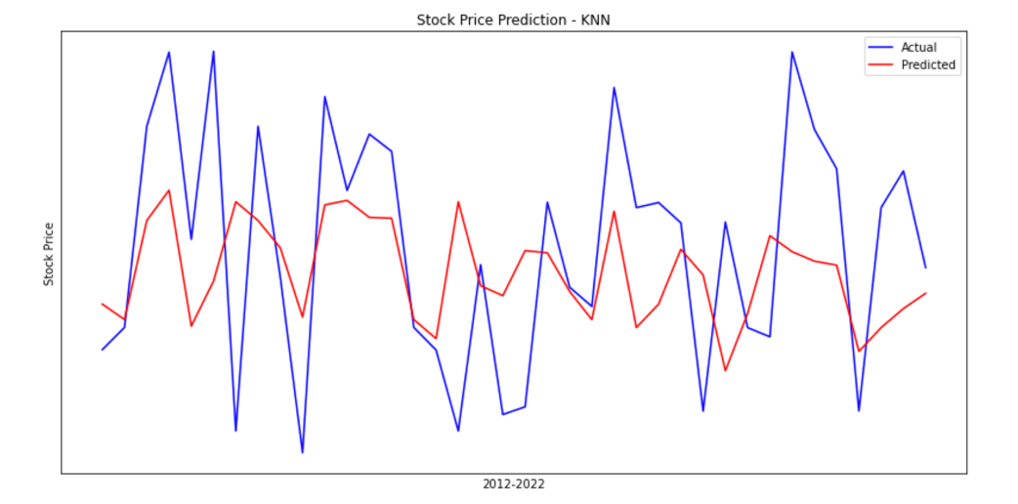

Comparative Analysis
Comparing multiple prediction models
KNN

Slide 14
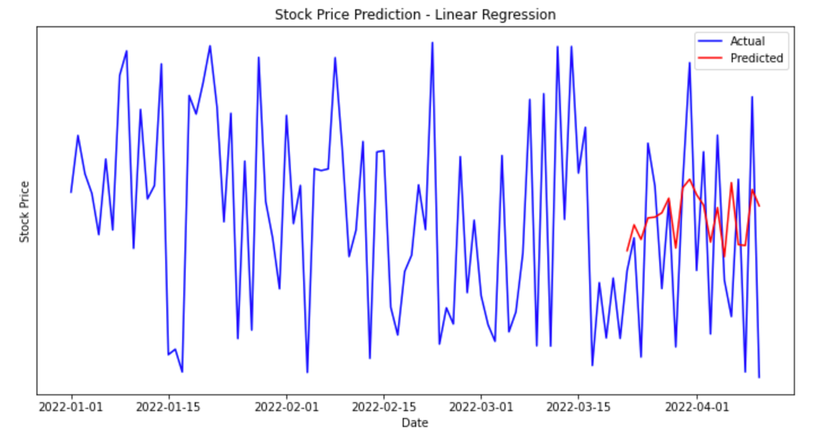
LINEAR REGRESSION

Slide 15
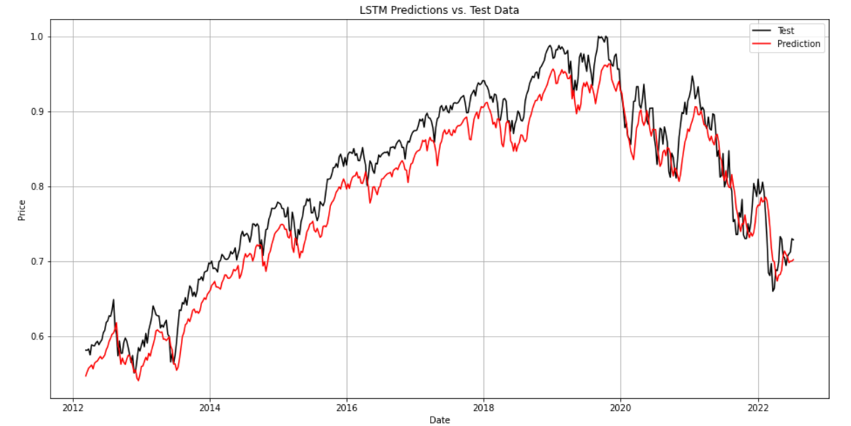
LONG-SHORT TERM MEMORY

Slide 16
KNN
Linear
Regression
LSTM
Root Mean square Error
Comparative
Analysis
0.23079
0.23079
0.02312
Mean Absolute Error
0.19129
0.18903
0.01876
R-squared
0.00826
0.00826
0.96269

Slide 17
Why does LSTM perform better?
Characteristics that make LSTM suitable for modelling and predicting stock market movements:
Capturing long-term dependencies in sequential data.
Handling sequential data inherent in stock price movements.
Utilizing memory cells to store and filter relevant historical information.
Automatically learning relevant features from the input data.
Offering flexibility in model architecture to incorporate additional features.
Capturing nonlinear relationships in stock price movements.
Predicting multiple steps ahead in a time series.
Leveraging large amounts of historical data for training.

Slide 18
Moving Average
Bearish Crossover
(death cross):
When the stock's price falls below its moving average, it’s generally considered bearish. It tells you that the stock has lost bullish momentum and is either pulling back to take a breather or entering a downtrend. If the latter, it suggests a selling or short-selling opportunity. A death crossing, a bad technical indication, happens when a short-term moving average crosses below a long-term moving average
– SELL signal
Bullish Crossover
(golden cross):
It often suggests that the stock’s momentum is starting to move upward, indicating a potential buying opportunity. When a short-term moving average crosses over a long-term moving average, a golden crossing, a positive technical signal, takes place
– BUY signal

Slide 19
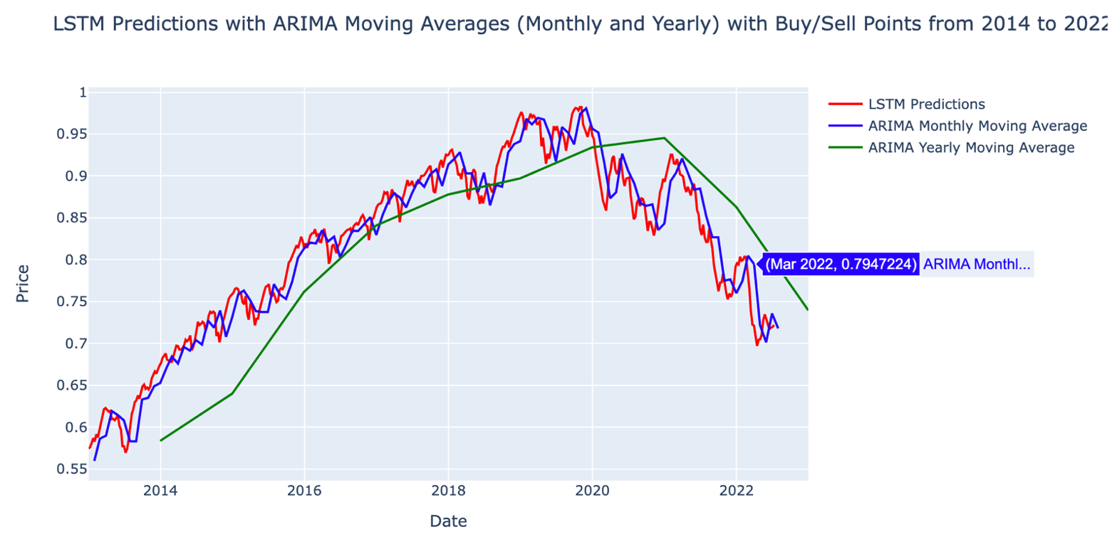

Slide 20

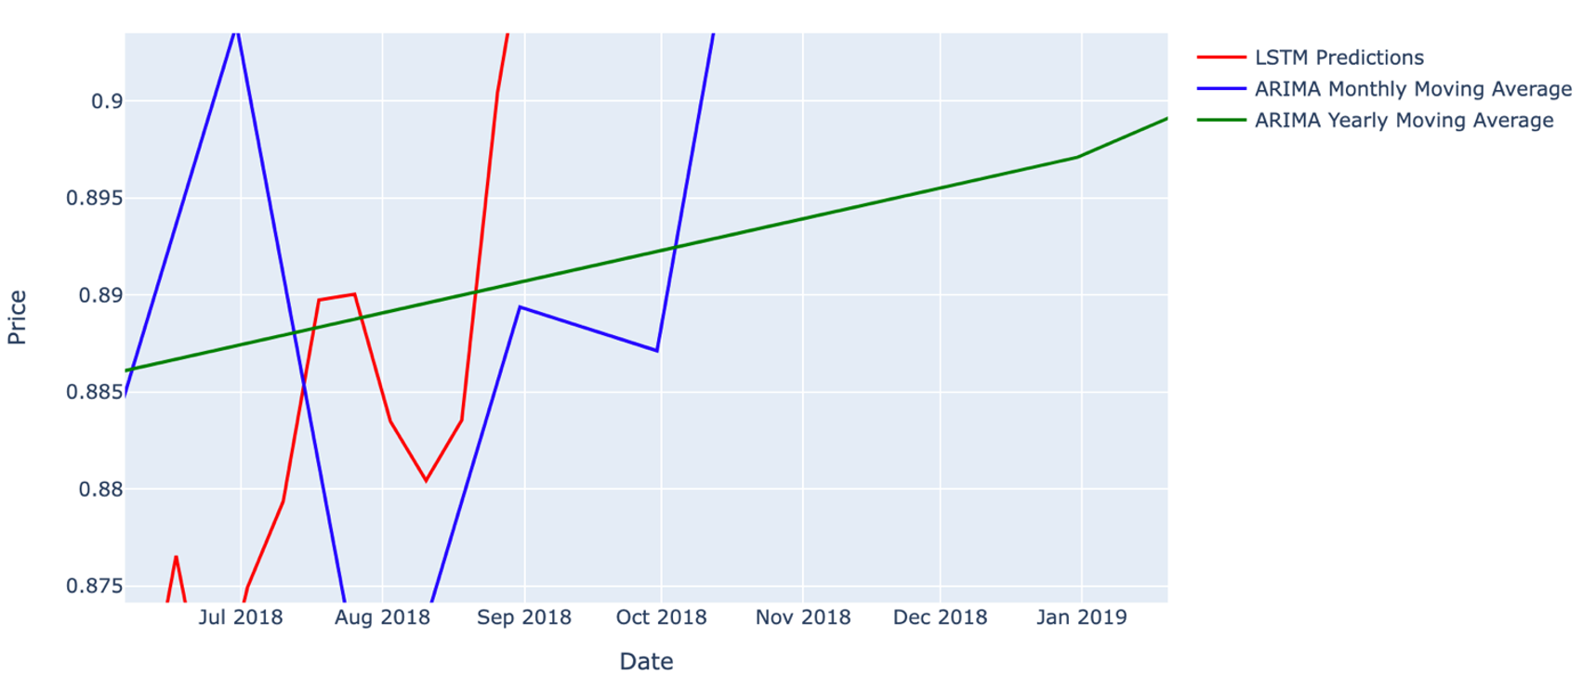
‘Buy’ Signal

Slide 21

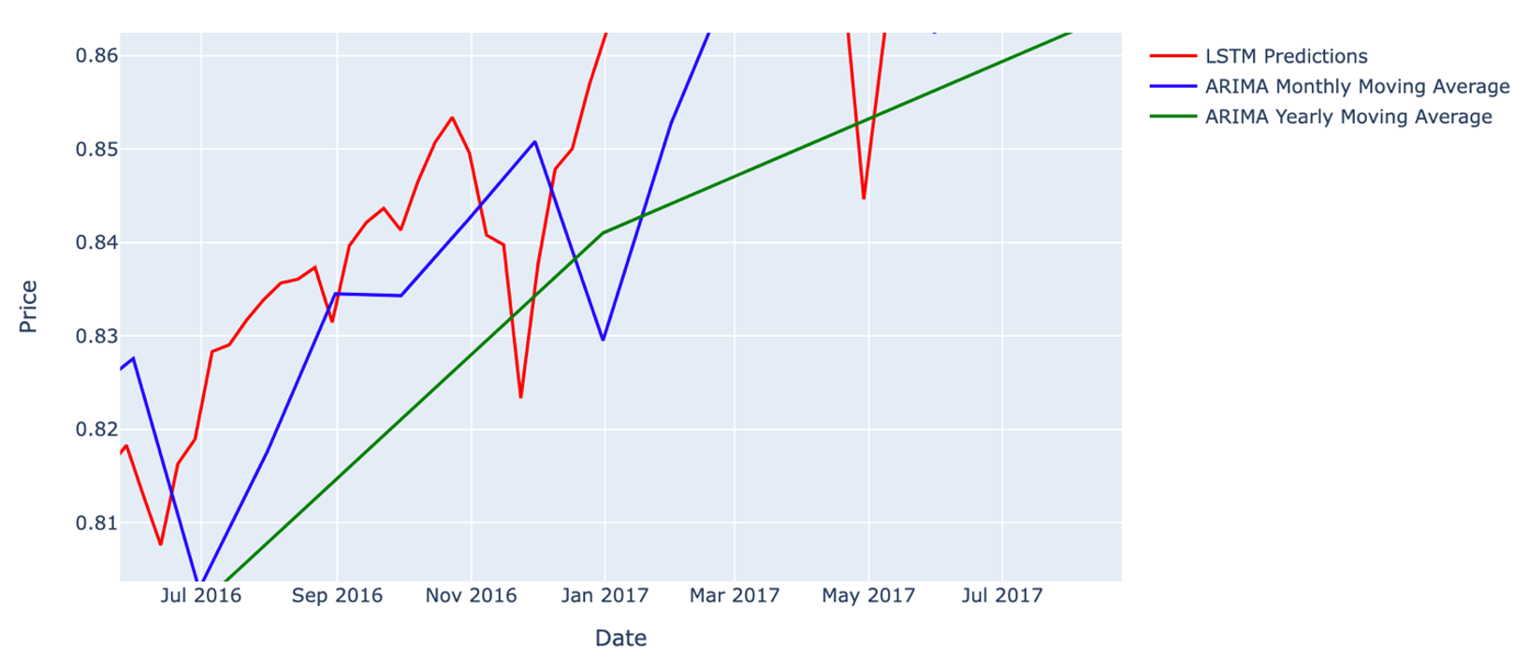
‘Sell’ Signal

Slide 22
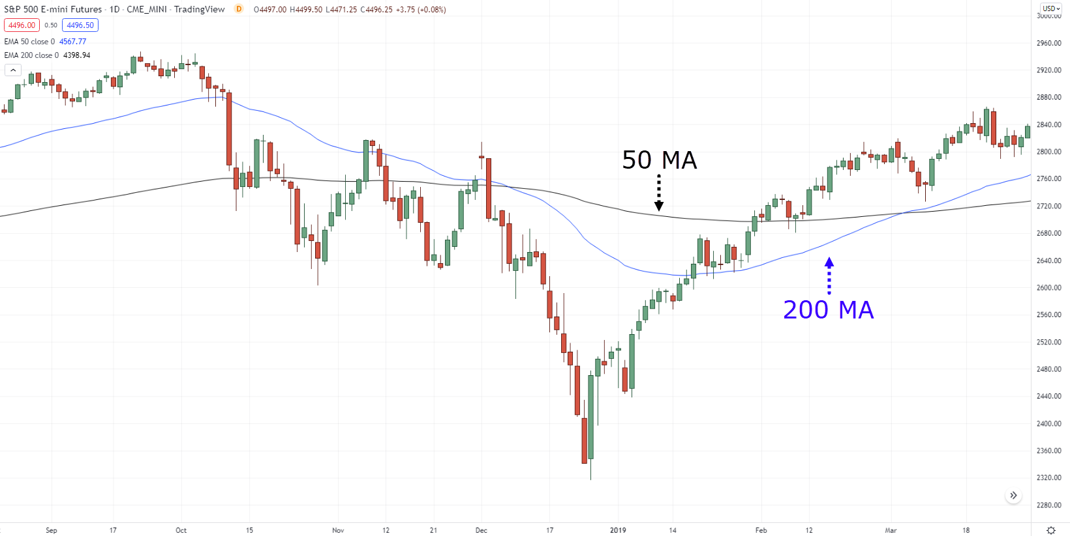
But is it a 100% effective? NO.

Slide 23
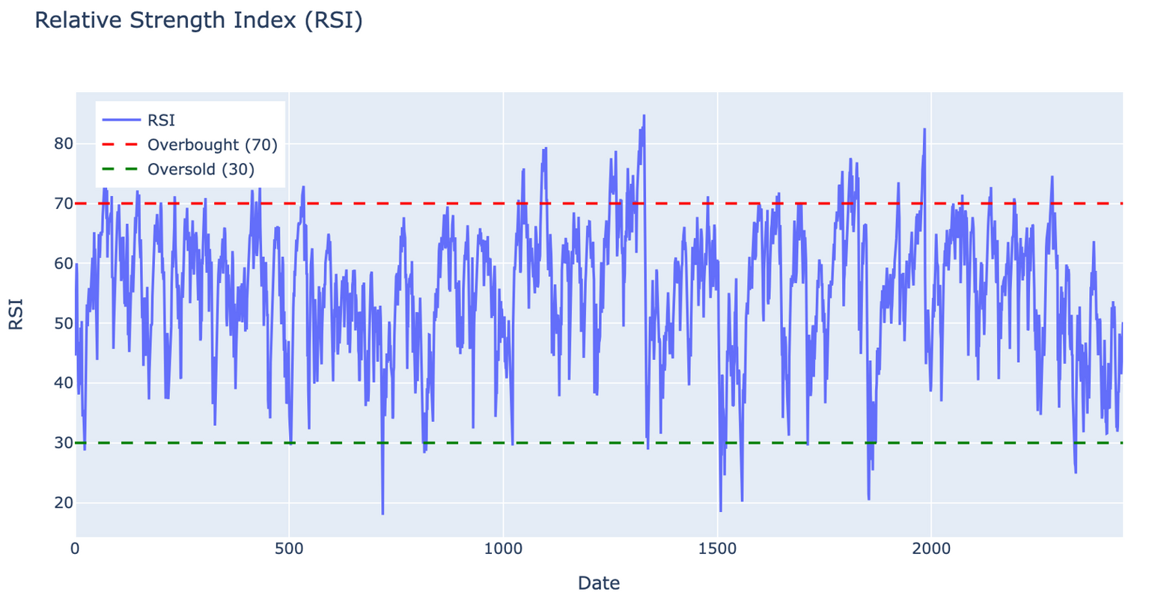
Relative Strength Index (RSI)
RSI is a momentum oscillator that measures the speed and change of price movements on a scale of 0 to 100. It is typically used to identify overbought or oversold conditions in a trading instrument.
This integration leverages the momentum information provided by RSI to condition the trading signals derived from moving average crossovers (as indicated by ARIMA analysis), enhancing the decision-making process for identifying optimal buy and sell points.

Slide 24

Conclusion
In conclusion, the application of LSTM and ARIMA models for stock market prediction offers valuable insights into market dynamics and trends. The LSTM model excels in capturing long-term dependencies and intricate patterns, while the ARIMA model effectively models short-term fluctuations and seasonality. By leveraging the strengths of both models, traders can gain a more comprehensive understanding of market behaviour and make more informed trading decisions.
The results obtained from LSTM and ARIMA models underscore the importance of using diverse modelling techniques to navigate the complexities of financial markets. While each model has its strengths and limitations, their integration can provide a more robust framework for predicting stock prices and identifying optimal trading strategies.
Moving forward, further research and development are needed to refine and enhance the predictive accuracy of LSTM and ARIMA models. Additionally, exploring the integration of other advanced machine learning techniques and incorporating domain knowledge could further improve the performance of stock market prediction models.
Overall, the findings from this study contribute to advancing our understanding of stock market prediction and provide valuable insights for traders looking to navigate volatile market conditions and maximize returns in the stock market. By leveraging the predictive power of LSTM and ARIMA models, traders can enhance their decision-making processes and capitalize on opportunities in the ever-changing landscape of financial markets.

